Slide 1
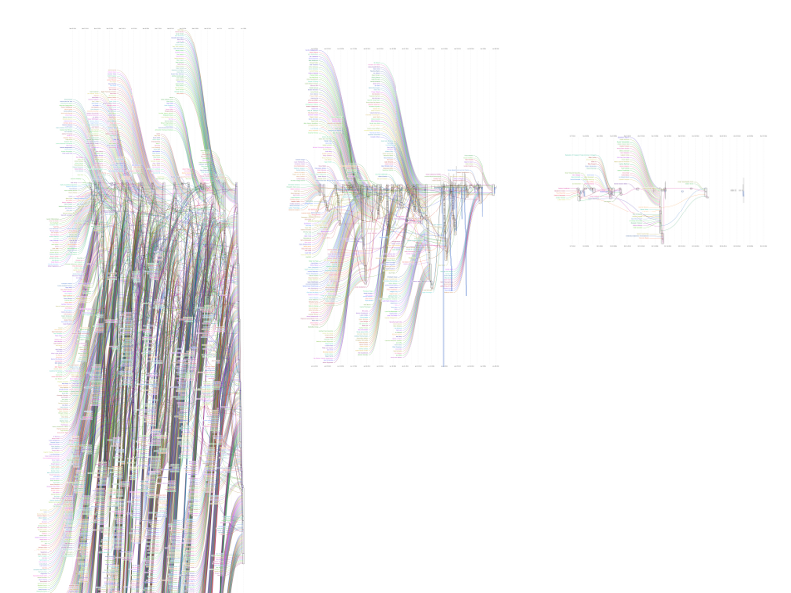
HOW DO WE CHALLENGE THE STEALTHY WORLD OF DIGITAL SURVEILLANCE?
Bev Skeggs, Professor
Director, Atlantic Fellows Programme
International Inequalities Institute, LSE

Slide 2
outline
Section 1:
the technical capacity that enables the competition for people’s data
what we know and how we know from “values and value: tracking the trackers” project
Section 2: Significance: stratification by stealth/digital subprime/racial capitalism
Section 3: The grand challenge: What can be done?

Slide 3
Tracking for trading…
As you finish this sentence if you have anything open on your laptop the chances are you will have been tracked and traded, especially if you are a high net worth individual with an influential group of friends, often in less than a millisecond (a thousandth of a second 1/1,000), likely over 100 times. In 2016 estimated 60k per day. Estimated double in trade now, over 50 billion times per day.
Uni of Cal study of Alexa (web traffic data analytics) found 5,000 trackers on the top 100 websites. Google is the top tracker. Google can track users across nearly 80% of sites through its various third-party domains.
Machine learning algorithms (which learn through tracking use and predicting future use) search for matches between what can be sold to whom
Every time you open a new webpage you are being assessed for trading potential (phones more protected than desk/laptops)
Even if you are not high net worth you will have been traded…… in a different arena, for different purposes, different products = debt
The primary purpose is behavioural advertising (predicting what you will buy)
BUT….not just about trading ….tracking is also used for state surveillance (market and state entangled)
You can turn your phone off. Turning off the Facebook platform makes no difference. You can’t turn off workplace trackers eg Saleforce used by HR companies.
Cookies can “respawn” or “regenerate” if deleted in history

Slide 4
Trading faster than the speed of light
120 milliseconds is about one-third of the time it takes a human to blink an eye
Bids are made by advertisers for access to your data 50 billion times a day, or about half a million times per second.
100,000 requests from advertisers per second (Any longer than that, and it threatened to delay the Facebook page load).
Light travels fast (299,792,458 meters per second), but not fast enough.
In 2014 Facebook had 52,000 unique attribute data signals on one profile. It buys other data to develop this profile.
Facebook continually uses machine learning algorithms (with over 100,000 signals) to experiment with your data to enable it to match to advertisers. You provide the signals every time you use the internet eg device used, speed of connection, browsers, emails, webpages, banking, language in messaging, videos watched, reactions to, click bait, location data, your networks, plus historic data, plus data bought from brokers.
One person’s data signal: XGQnGPA1MCmThgb9wN4vL0UpgBUUtWg.rg.FTN.0.AWUxZtUf
From Antiono Garcia Martinez (Facebook Product Manager 2016) “Chaos Monkeys”
Advertising use of programmatic marketing is the digital industry equivalent of financial flash trading (see Michael Lewis’s “Flash Boys”)

Slide 5
Programmatic advertising: milliseconds
Most of today’s digital advertising takes place in the form of highly automated real-time auctions between publishers and advertisers; this is often referred to as programmatic advertising. When a person visits a website, it sends user data to a variety of third-party services, which then try to recognize the person and retrieve available profile information. Advertisers interested in delivering an ad to this particular person due to certain attributes and behaviours make a bid. Within milliseconds, the highest-bidding advertiser wins and places the ad. Advertisers can similarly bid on user profiles and ad placements within mobile apps.

Slide 6

ESRC funded (2013-2016, ES/KO10786), with support from Sociology and Computer Science, Goldsmiths, University of London – interdisciplinary project
https://values.doc.gold.ac.uk/
https://values.doc.gold.ac.uk/firstfindings/
Professor Bev Skeggs and
Dr Simon Yuill

Slide 7
What we did: very mixed methods
A random digital survey of people’s use and attitudes to use with 154 participants
A Facebook App that provided data about participants’ activity from the Facebook API, including all user-generated posts in their newsfeed with which they had interacted (with their permission)
A plug-in for Firefox browsers, called Admonitor, that gathered data we were not able to collect directly from Facebook itself (this included advertising shown on Facebook, the order of posts as they appear at the top of users' Facebook timelines, and advertising included on other sites via systems such as GoogleAds).(with participant’s permission)
It took 6 months to write the software as it was frequently interrupted by Facebook’s changing code.
Developed heuristic device to analyse 200million ad words
A live website provided daily visualizations of the data as it was collected –participants could see tracking and interactions
Generation of databooks to enable the reading across different data
Post-data collection interviews with 15 participants to review their databooks with them
We were registered as Facebook developers and of our participants 33 managed to register as Facebook testers. See https://values.doc.gold.ac.uk/interactions/
All software is open source and designed by Dr Simon Yuill available at: https://github.com/valuesandvalue
We tell the story of the difficulties in “The Methodology of a Multi-model Project Examining how Facebook Infrastructures Social Relations” (in Information, Communication and Society, 2015). Open access.

Slide 8
Rhythms of interaction: “lifeness”
Research question: what happens when
intimate relations eg friendship are monetized?
The project began as a study of social interactions, ended as an investigation into new forms of capitalism
In 2013 I asked in a public lecture:
“Values beyond value: Is anything beyond capital?”
https://values.doc.gold.ac.uk/interactions/

Slide 9
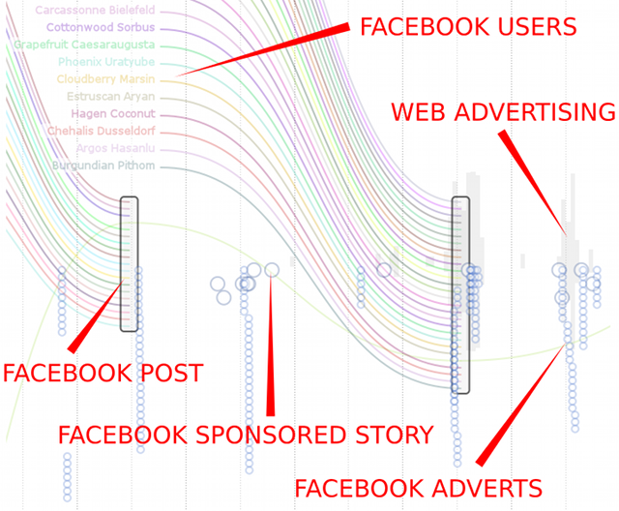
Key to interaction flows:
NB: the grey matter, behind the Facebook platform

Slide 10
https://values.doc.gold.ac.uk/firstfindings/

Slide 11
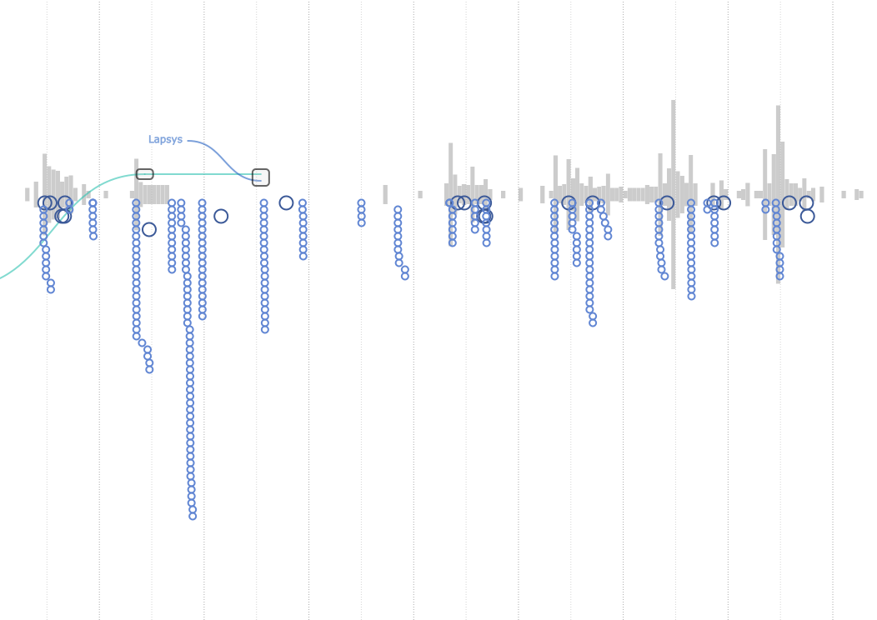
Grey matter = tracking on browser

Slide 12
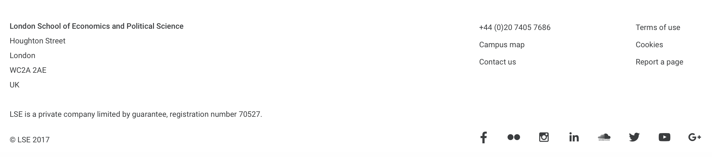
You do NOT have to be on the Facebook platform in order to be tracked.
You just have to be on an internet page with a link to Facebook/Google/Twitter/ = nearly all.
Check the bottom of the page you are on for the f symbol eg:

Slide 13
Manipulating the news feed for attention
https://values.doc.gold.ac.uk/firstfindings/

Slide 14
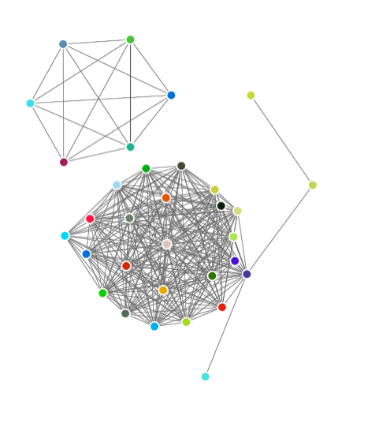
Significance of influence/influential networks
Dynamic network without participant
Loose networks made it more difficult for FB to profile
Tight and influential networks enable FB to build profile from friends and target more effectively

Slide 15

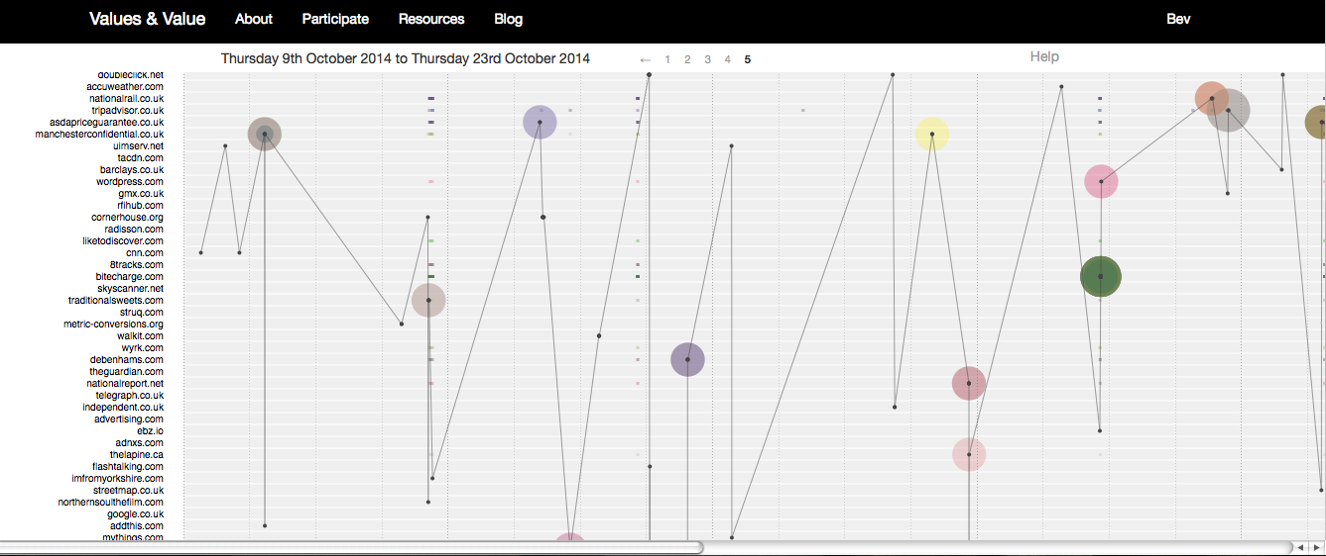
FB tracking of general browser use – collating all sites data, keyword matching- enable profile building
Sites tracked by Facebook
=data extracted when ad words correlate with tracker source
Information embedded in URL’s of online adverts and trackers
https://values.doc.gold.ac.uk/

Slide 16
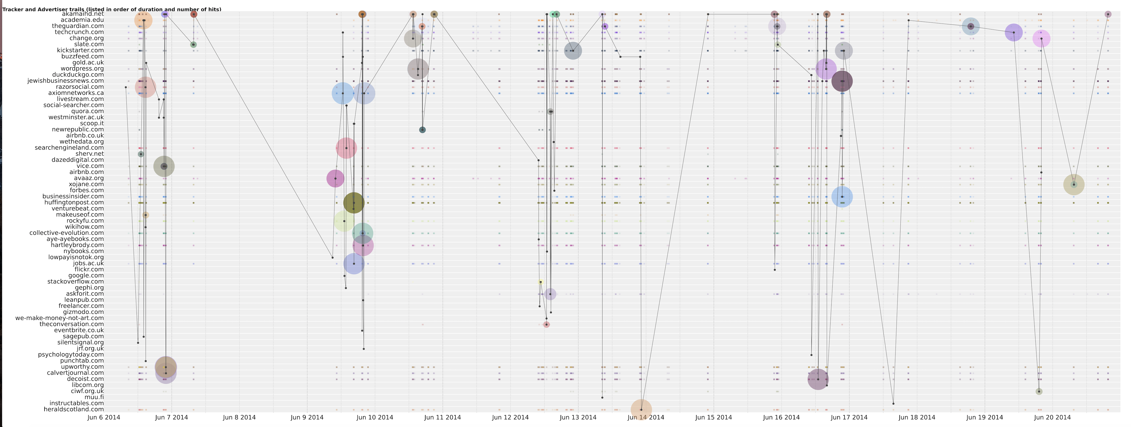
The trail of Facebook as it tracks your activity on other websites. The most visited at the top.
The circles are scaled to a size that represents their relative size to the number of ads that have shown a match
(in real time you can see how many times you have been targeted by a particular ad company on your Facebook platform

Slide 17
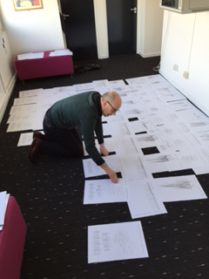
Simon Yuill, software
Designer
Too much data for screen analysis,
then we ran out of floor

Slide 18
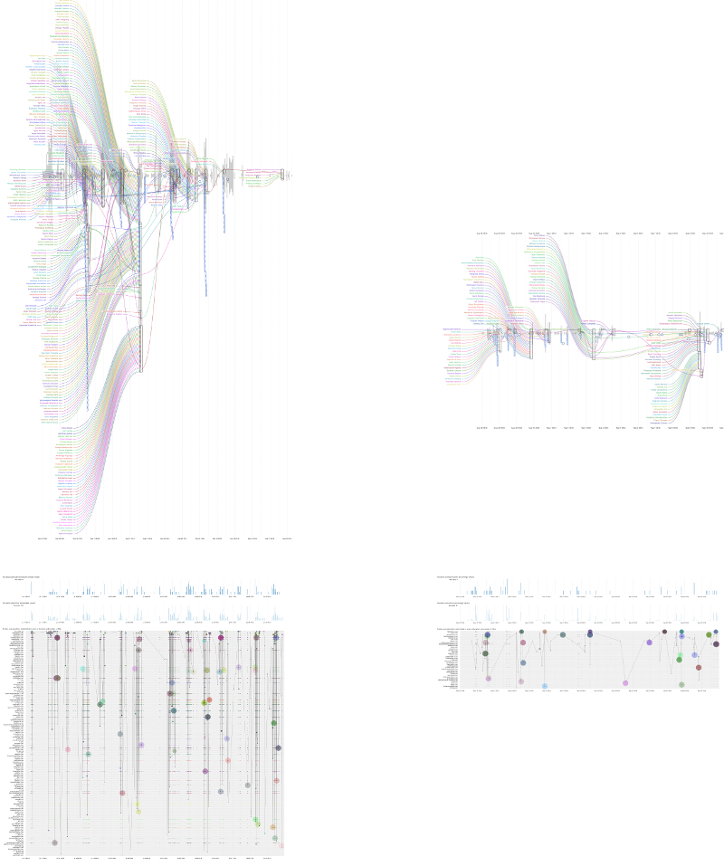
Significance: Stratification and lock down by stealth: “Worth (Lara on the left) and waste”(Belle on the right) W/W = marketing classifications)
Those who are not sold commodity objects were targeted for debt…….

Slide 19
Section 2: significance
phenomenal machine learning capacity to analyse your every move
Remember: Facebook continually uses machine learning algorithms (with over 100,000 signals) to experiment with your data to enable it to match to advertisers. You provide the signals every time you use the internet eg device used, speed of connection, browsers, emails, webpages, banking, language in messaging, videos watched, reactions to, click bait, location data, your networks, plus historic data, plus data bought from brokers.
ML + storage: And now even more data can be analysed via cloud capacity

Slide 20
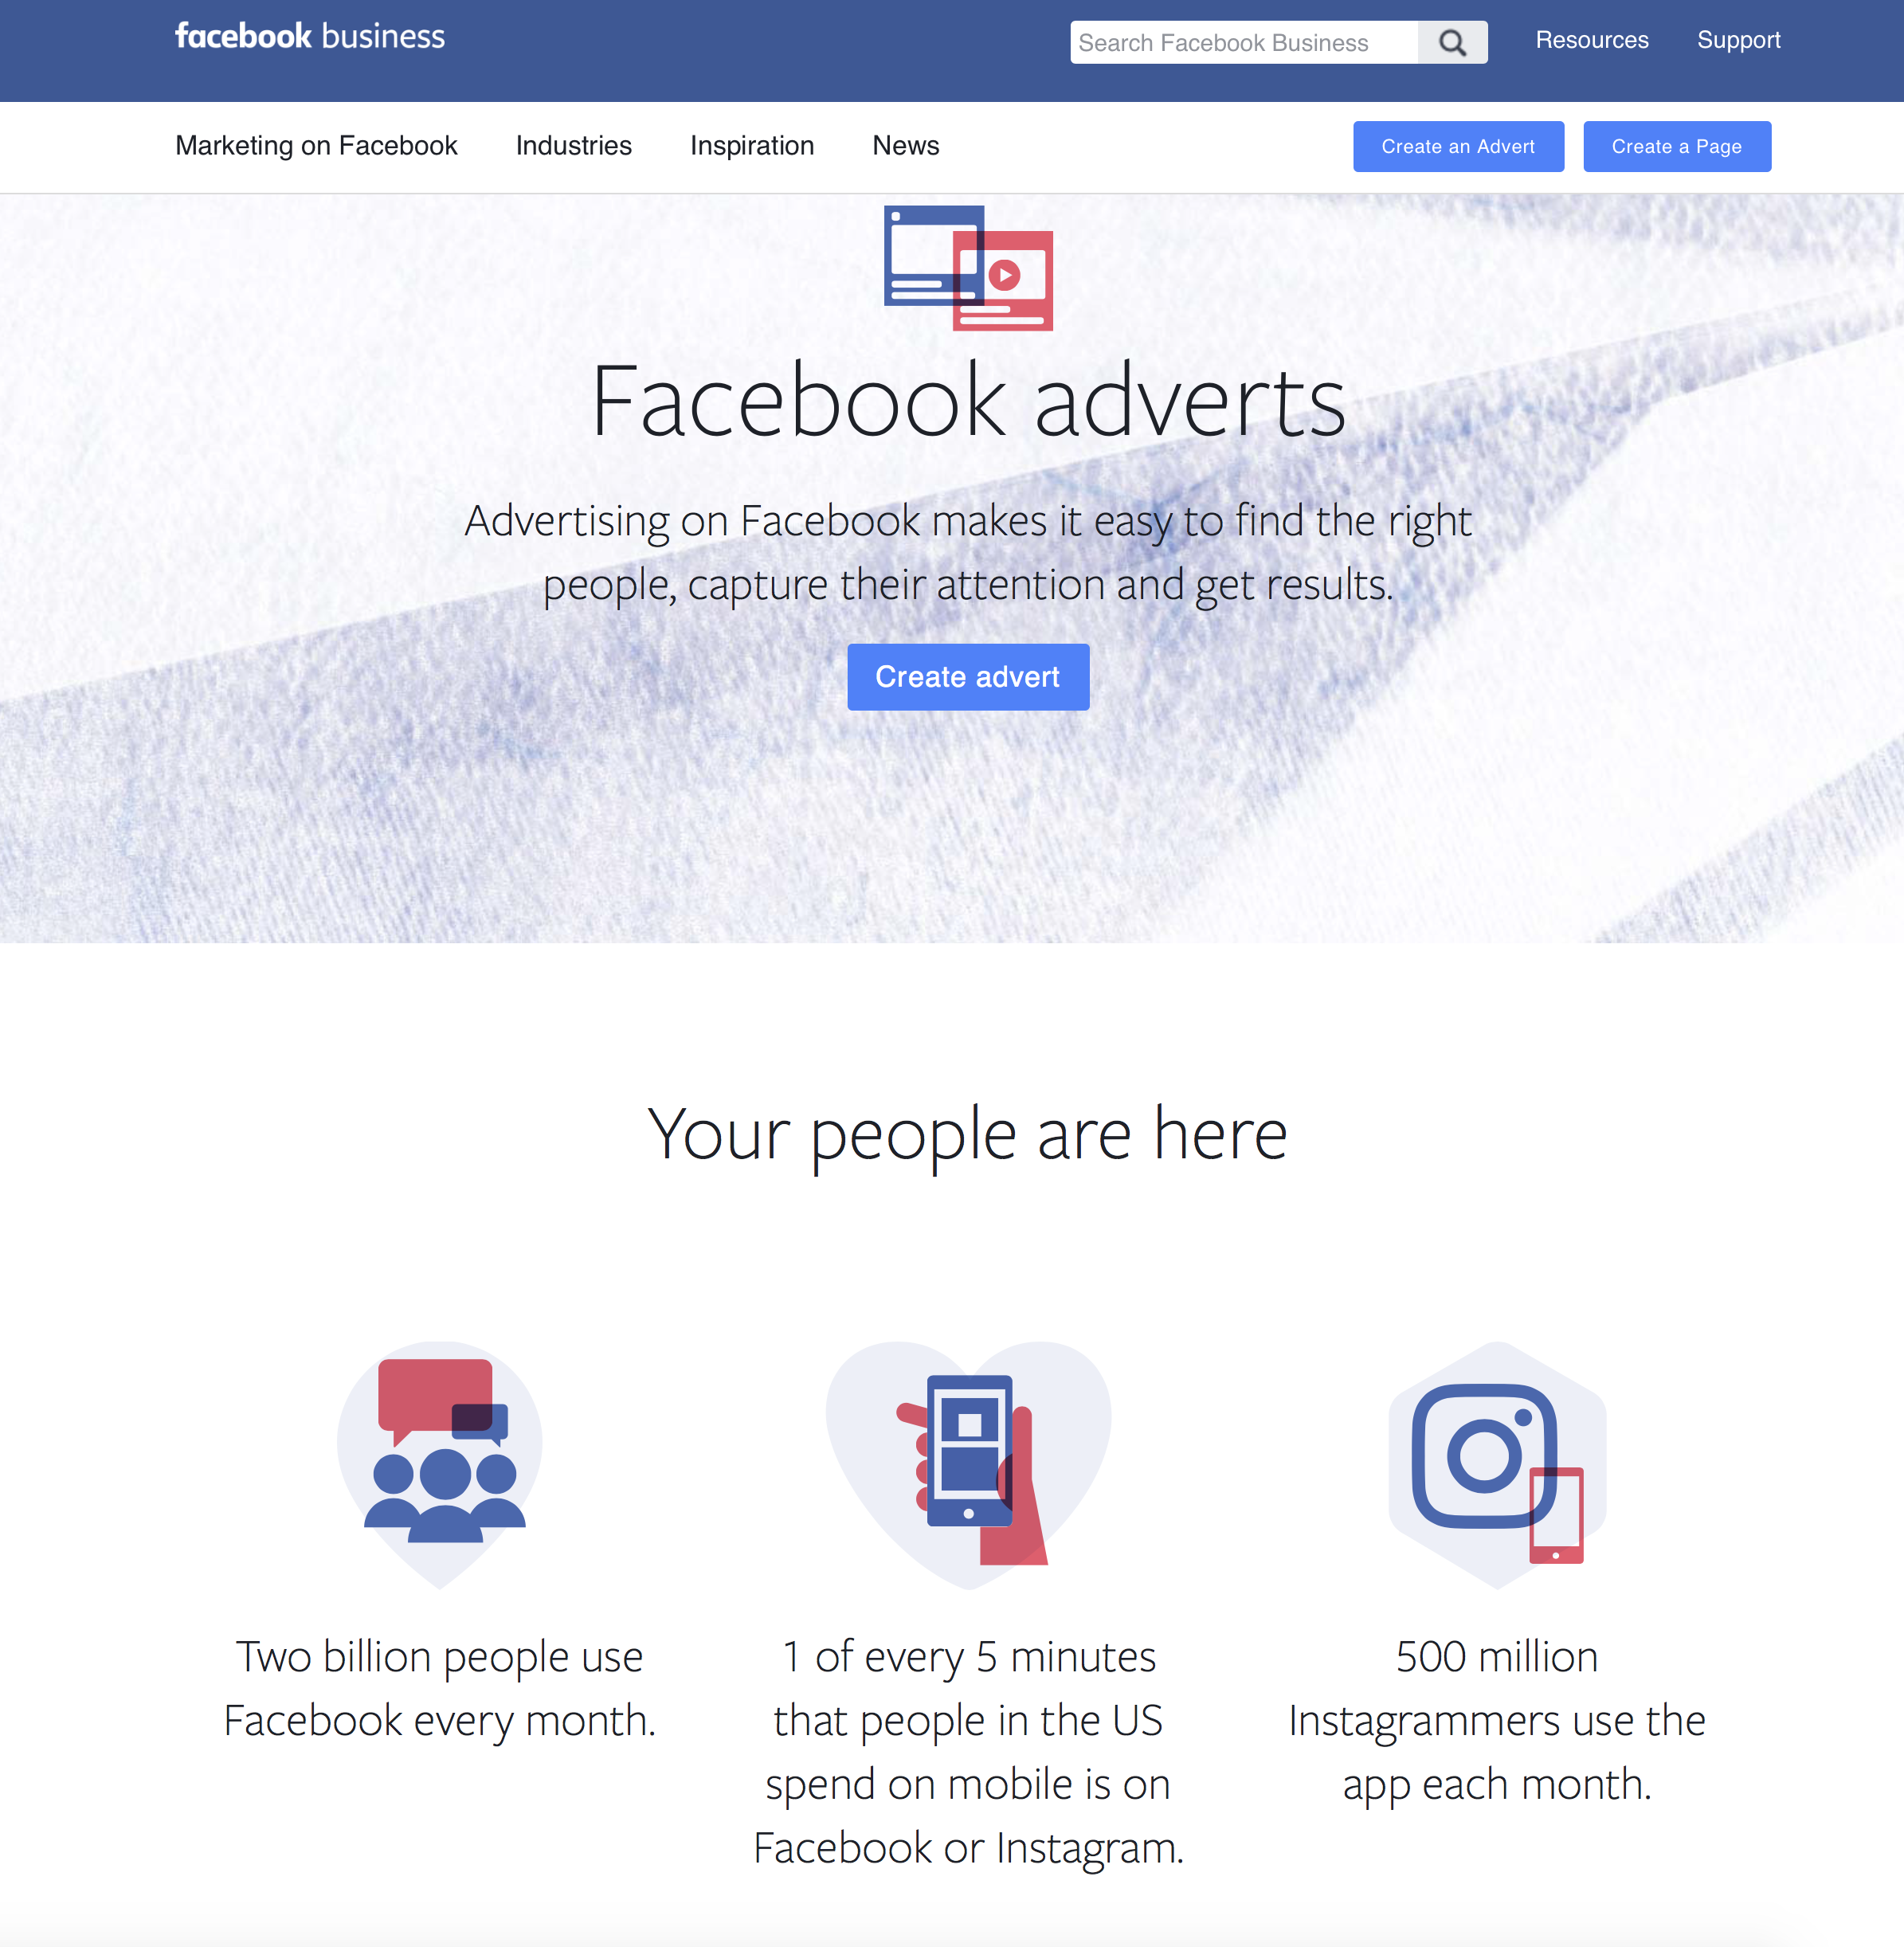
Why so much tracking and trading?
PROFIT: To make money, pay shareholders, invest, growth.
The majority of Facebook’s revenue 97% comes from advertising
Facebook market capitalisation (intraday): $270.37billion (16.10.15), $312.3 (04.03.16) $ 321.97 (20.04.16) $369.04 (03.10.16) $451.36 (24.09.17). $535.07 (09.03.18) $454.02 (09.10.18) 02.12.18 $404.08b (02.12.118), $471.71 (25.02.19) source: NASDEQ
To keep ahead of the market against competition, hence have to control competition eg Instagram, what’s app
To be able to sell itself as having the “best matching” of consumer to advertiser.
New patents issued Nov 2018 to “refine” targeting
Eg USP =

Slide 21
New monopolies, digital colonialism: an indispensable global utility
FB follows the “traditional logics of capital’: consolidation of interests via monopolization of different fields, diversification globally
Eg consolidation through buying other companies (Whats App, Instagram)
Eg diversification: eg games in developing countries, “free basics” in 86 countries (2018); mobile banking in China (beaten by superapp WeChat); P2Ppayments eg via messenger; drones; 3D, dumb phones, telecommunications takeover by Whats app; Facebook for SIM in Argentina, Chile, Columbia (digital colonialism?).
The value of a company’s assets is not so much a function of the products and services it produces as of the ability to control risk via image, branding, development, IPs, trademark, copyright, trade secret laws, patents and licensing: the overall control of knowledge.
FB creates value through proprietary rights (Bohm and Land 2012; Harvey 2005; Ekman 2012; Perelman 1998) which along with the above comes from access to and rights over to your data – your agree to the right for FB to use your data
Facebook creates monopoly making a ubiquitous and unavoidable utility – operates in a similar way to electricity – necessary for network connection (eg spotify needs the Facebook platform to operate – only known when FB crashed and nobody could use Spotify).

Slide 22
Facebook business says about its advertiser auctions
“Advertising on Facebook makes it easy to find the right people to capture their attention”
The advert auction determines which adverts should be shown to which people. Using information that you provide in the advert creation process, the auction shows your advert to the people (algorithmically matched) who are most likely to be interested in it
When showing ads, we try to balance two things:
Creating value for advertisers by helping them reach and get results from people in their target audiences
Providing positive, relevant experiences for people using the Facebook family of apps and services
“Our goal is to match the right ad to the right person at the right time”.
It is selling access to your “eyeballs” and charges according to how valuable your eyeballs are! (eg do you have the purchasing power, are you likely to buy, what else have you bought recently, what are your spending patterns, how much debt, etc.…)

Slide 23
We found they also sell access to other data auctioneers to
trade your data eg:
The Rubicon project . Established 2007, went public in 2014.
Now controls
More than 50,000 algorithms
75 billion transactions per day
6x the trade daily of NASDEQ
14 global offices
Tracks with API’s, cookies, web-beacons, Chango a keyword tracker
Known as “programmatic advertising/marketing”
Restructuring the advertising industry as demands for “creatives” diminished by the speed and power of algorithmic auctions
All checking your browser use via machine learning algorithms

Slide 24
We also found data brokers extracting data from the FB platform: FB also buys data from data brokers to enhance the profiles it develops
We had 1,968 examples of Acxiom, 23 from Experian. In 2015 Acxiom brags that it has, on average, 1,500 pieces of information on more than 200 million Americans.
Oracle collects 3 billion profiles from 15 million websites and 700 million social messages daily. One of its specialties is the tracking of TV viewing habits.
Competition between is intense
All based on real-time scoring when all signals you send (eg web browsing, detected through tracking) is sold as a “hit”(match) or packaged to develop a profile of your “worth”
There is a great deal of competition by stealth to collect information on how best to profile you. Remember this comes from a range of sources: government data (eg social security, national insurance, NHS Google sifted in UK, criminal stats, all purchases, credit cards, ATMs, all browser use, owning a cat! plus geo-demographic, everywhere you go, when you look at digital adverts on the street.
Everyday life has been colonised by data extractors and traders, all in the interests of advertising/directing consumption.
US Federal Trades Commission reported (2014) it is impossible to find out how you are being packaged and sold. You can’t even find out how these data brokers collected all the data they have on you. You may never know.
Or you may find out when you realise something has gone badly wrong (50% inaccuracy: World Privacy Forum Report 2014). Experian’s credit arm had 15 million customers’ information, including social security numbers, breached in 2015.
Beyond regulation.
See report by Wolfie Christl and Sarah Spiekermann (2016)

Slide 26
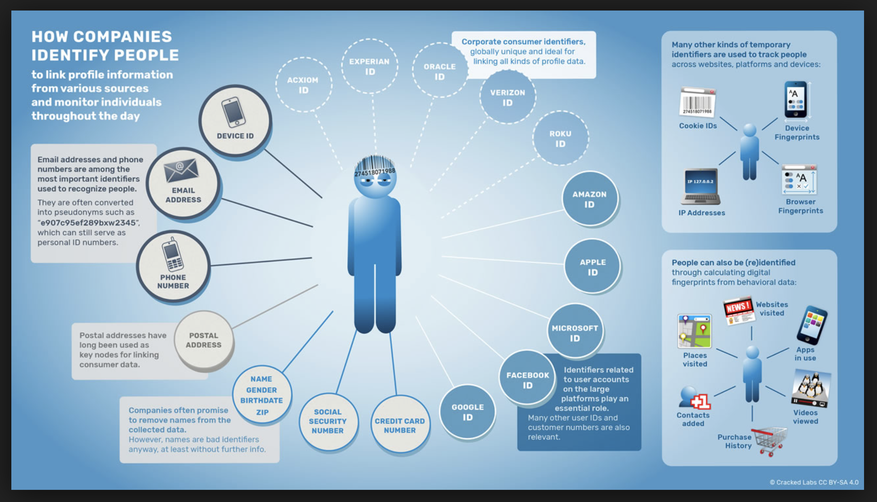

Slide 27
Data brokers plus Facebook – trading between
FB has “social data” eg speech patterns, head movement, face recognition, friendship networks, rating of influence, affective responses, which gives them an advantage in profiling. But only IF combined with all the other demographic data eg from Experian (traditional DBs) GPS, health, welfare, consumption data, some which it buys off other data brokers to extend and build a person’s profile.
All data controlled through intellectual property rights.
Facebook since (Jan 2018) has access to all financial data in Europe: as a result of a European Directive PSD2 “open banking”, it will be able to access the API’s of traditional banks and experiment with that data without regulation (as long as you have signed away your rights via permissions).
FB operates as a metadata economic ecosystem (all data flows through eg other platforms like Spotify) Haynes and Nguyen 2014)

Slide 28

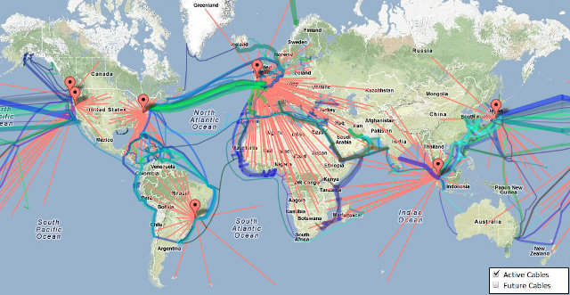
Utilities and Octopuses: Amazon Web Services
“Let’s give them credit. The book guys got computer science, they figured out the analytics and they built something significant”
Eric Schmidt, CEO, Google
Notes:
A key part of digital infrastructure. It provides infrastructure for CIA, many other govts, tech startups like Netflix, ITF research team.
35% market share of cloud computing. More than Microsoft, Google, IBM, Alibaba combined
Again - amazing growth in revenue and profits
Revenue growth, between 40% - 80% every quarter
Profit centre for the group. Making 20-25% margin. Rest of group 3-5% in a good quarter

Slide 29
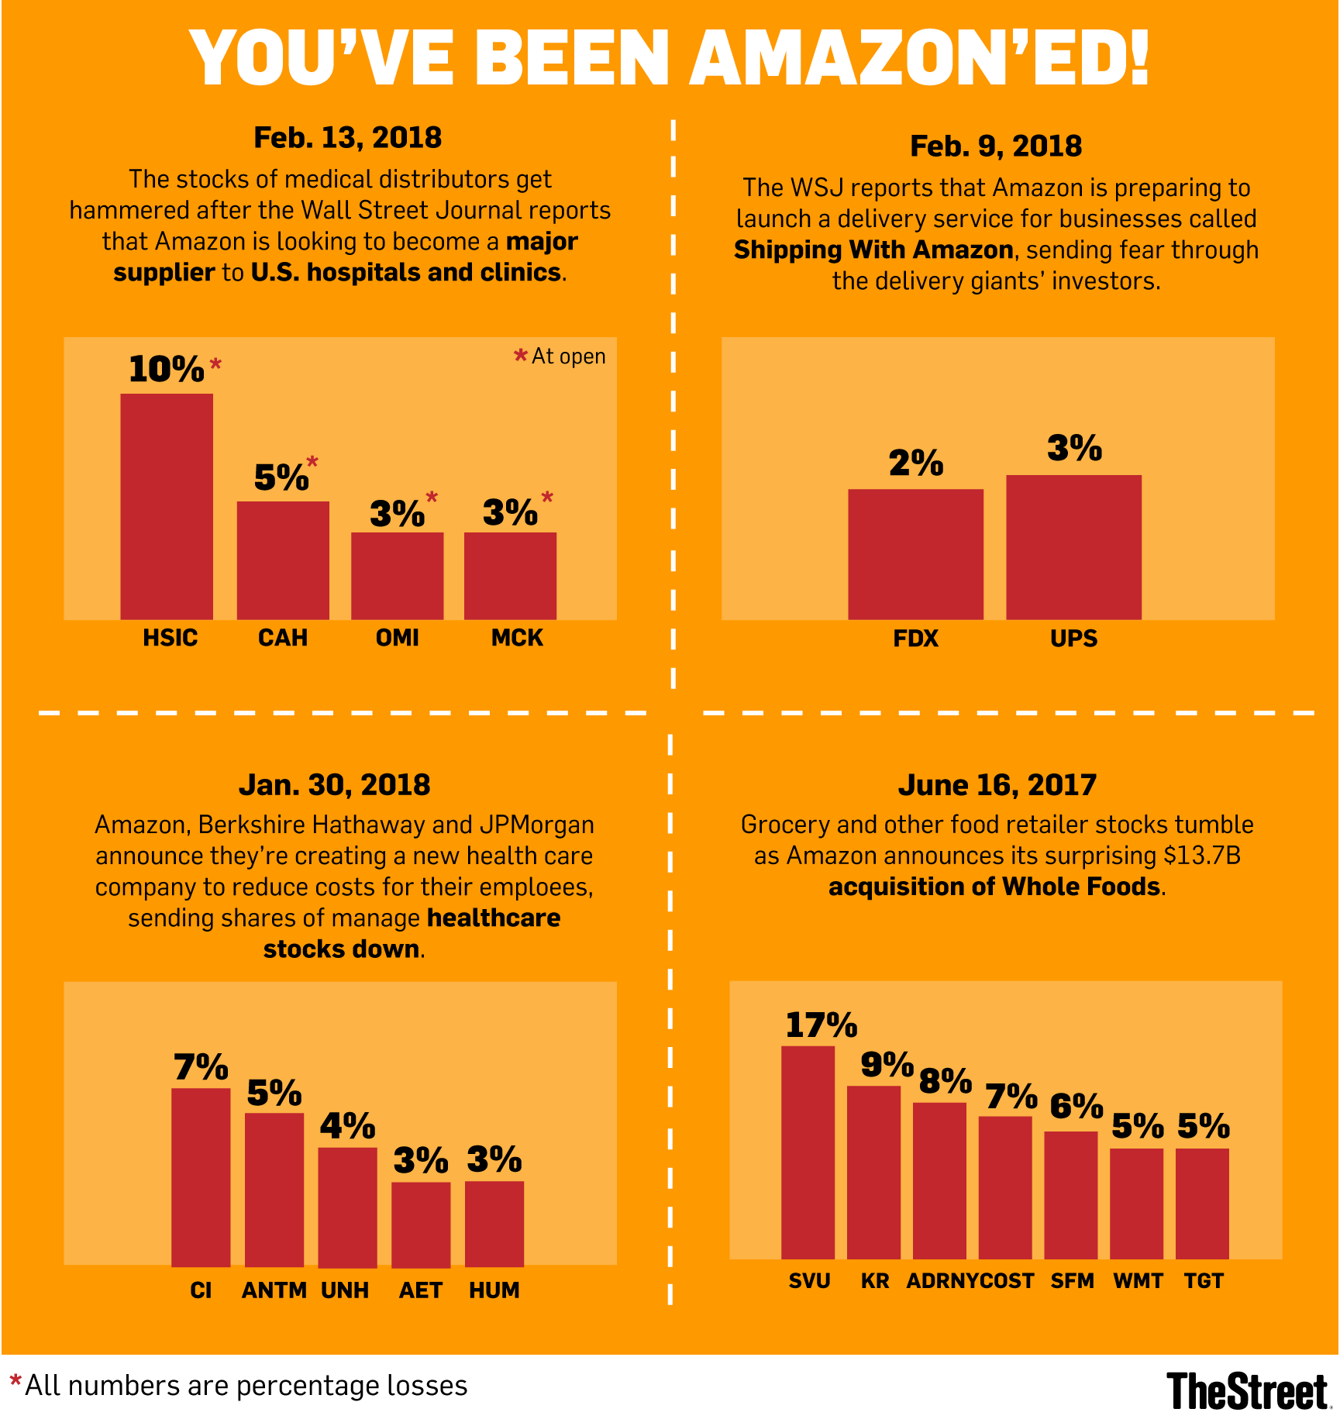
Retail | Amazon.com
Grocery | Amazon Fresh WholeFoods
Cloud | Amazon Web Services
Media | Prime Video
AI | Amazon alexa
Finance | Amazon Payments Amazon Lending
Healthcare | Amazon Healthcare?
Transport | Fulfilment by Amazon Shipping with Amazon Amazon Air Amazon Flex Delivery Service Partners
Food Delivery | Amazon Restaurants
Notes:
Rework the other side

Slide 30
Global technical infrastructure
Amazon is another key part of the global digital infrastructure. It provides infrastructure for CIA, many other govts, tech startups like Netflix.
Connected to and through other cloud infrastructures such as “Salesforce” which has more worker’s data than any other platform
Amazon has 35% market share of cloud computing. More than Microsoft, Google, IBM, Alibaba (China) combined
Revenue growth, between 40% - 80% every quarter (on 04.09.18 Amazon value topped 41 trillion)

Slide 31
Big data is big
Any info practice associated with big data represents an undemocratic shift insofar as they are reliant upon access to huge and costly databased as well as the processing power and technological know-how to make use of the data.
Data –creep: repurposing the original data for other purposes (eg FBI’s use of grocery store data in San Francisco in the hope it would lead to Iranian terrorists. (Facebook data by Cambridge Analytica for for Brexit promotion).
Palantir (Peter Thiel- Trump’s tech advisor, PayPal, FB funder) used social media date, family histories and friendship networks for predictive policing in New Orleans. They were registered as a philanthropic trust.
All data is relevant – tracking all the signals they can capture – “we cannot connect a dot we don’t have” (CIA)
Machine learning “thinking without understanding”. The move from comprehension to correlation and often inaccurate prediction that cannot be corrected.

Slide 32
Failure to regulation global oligopolies
In June 2015 a national government (Belgium) tries to block Facebook tracking non-Facebook users without their knowledge or permission (eg our grey matter).
It employs 5 US computer science departments to collect evidence of tracking. Until this point (June 2015) Facebook has denied that it is tracking non-users of its platform.
They found that Facebook tracks the web browsing of everyone who visits a page on which its logo is inserted. It tracks the computers of users without their consent and tracks those who do not have a FB account.
When a user visits a third-party site that carries one of Facebook’s social plug-ins, it detects and sends the tracking cookies back to Facebook.
They also found that the opt-out mechanism on FB actually enables tracking
However, on June 29th 2016 Facebook Wins Appeal against Belgian Court Case Over Storing Non-User Data
The ruling was based on the fact that Belgian courts do not have international jurisdiction over Facebook Ireland, where all data concerning Europe is processed.

Slide 33
Entwined, entangled, captured and...”integrated” (2015-2018)
Special arrangements detailed in internal Facebook documents gave Microsoft's Bing search engine access to the names of all Facebook users' friends without consent and allowed Netflix and Spotify to read Facebook users' private messages, the Times reported.
Other arrangements allowed Amazon to obtain users' names and contact information through their friends and permitted Yahoo to view streams of friends' posts as recently as this summer, the Times reported, despite Facebook's statements that it had ended that type of data sharing.
Facebook had arrangements with more than 150 companies -- mostly in the tech industry but also in the automotive and media industries -- to provide access to the data of hundreds of millions of people each month.
Still denies data breach! Disregard for legality. Doesn’t turn up. Tiny fines (if any). New York Times Dec 18. 2018
From: Carole Cadwalladr 2017 The Observer
(illustration by James Melaugh

Slide 34
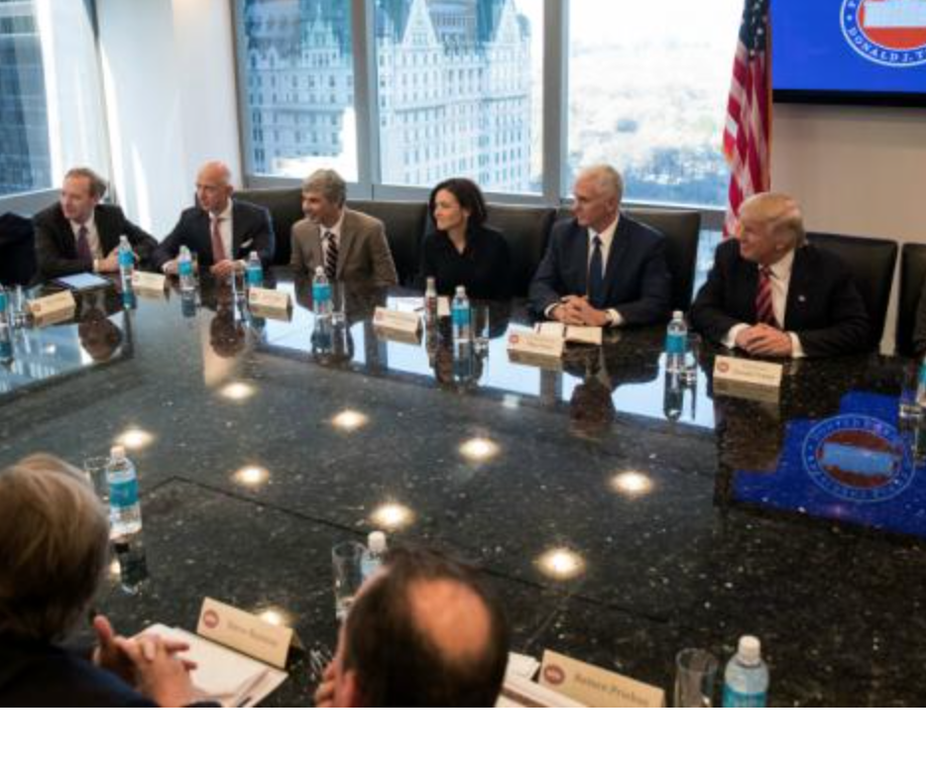
Lobbying power:
Over the past 10 years, the country’s five largest tech firms have flooded Washington with lobbying money to the point where they now outspend Wall Street two to one.
Google, Facebook, Microsoft, Apple and Amazon spent $49m on Washington lobbying last year, and there is a well-oiled revolving door of Silicon Valley
Or just taking power: Peter Thiel (Trump’s tech advisor, co-founder of Facebook, PayPal, Founders fund, Palantir, Sea steading movement Institute –claim: ”opening humanity’s next frontier”– see Roger Burrows)

Slide 35
Tax avoidance vehicles
Facebook’s tax avoidance strategies have enabled it to keep a substantial share of its capital.
Based in Ireland. In 2014 in the UK Facebook claimed it ran at an operating loss of £28.5m, paying only £4,327 in corporate tax for the whole year despite claiming that at least 1/3 of the UK population visited its site, with 32 million Facebook users, declaring £105m in UK revenue.
On 4th March 2016 Facebook announced it will pay corporation tax in the UK for the tax year 2015-16 from advertising revenue generated from April 2017 (However in October 2016 it paid only £4.2m).
The company said revenues in the UK rose from £210.8m to £842.4m for the year to 31 December 2016, helping pre-tax profits increase from £52.5m to £58.4m for the period, according to accounts filed at Companies House. But its UK corporation tax only rose to £5.1m from £4.2m a year earlier, and after deductible expenses the company paid only £2.58m.
It was planning to pay between 2015-2018 some £280m in share bonuses to staff - around £775,000 each - reducing the amount of net profit on which FB would have to pay corporation tax. (but increasing the amount staff would have to pay!)
The British tax collecting agency HMRC spent £27,000 on adverts with Facebook in the past year. Very little state regulation.
http://www.theguardian.com/technology/2016/mar/04/facebook-pay-millions-more-uk-tax-reports
EU campaigning to collect tax.

Slide 36
significance
Unavoidable surveillance and capture
Stratification by stealth
No accountability
Difficult to regulate

Slide 37
Remember: stratification by stealth, Belle is sold debt

Slide 38
The new humanity = digital sub-prime, old racial capitalism, impoverishment for many
No algorithmic accountability
The already impoverished are targeted for predatory financial products, payday loans, online classes or debt relief services (Federal Trade Commission Report on Big Data 2016). Techniques such as “lead generation” rely on targeting the vulnerable, what Jackie Wang (2017) calls the new racial capitalism which begins with parasitic governance and predatory lending that extends credit only to dispossess later.
Predatory lending has a decidedly spatial character and exists in many forms, including subprime mortgage loans, student loans for sham for-profit colleges, car loans, rent-to-own scams, payday loans, and bail bond loans.
Privacy is an economic positional good.
The already impoverished are targeted for predatory financial products, payday loans, online classes or debt relief services (Federal Trade Commission Report on Big Data 2016).
Predatory lending has a decidedly spatial character and exists in many forms, including subprime mortgage loans, student loans for sham for-profit colleges, car loans, rent-to-own scams, payday loans, and bail bond loans.

Slide 39
Generating digital inequality: also a different surveillance
Those already subject to conditions of impoverishment will experience more surveillance with higher stakes, harsher consequences and lack of resources to seek redress (Gandy 2009; Gangadharan 2012; 2015).
Madden et al. (2017) identify networked privacy harms in which users are held liable for their own behaviour and the actions of those in their networks.
They will be subject to excessive state surveillance: eg Job applications more likely to be a source of surveillance, and more likely to be subject to “threat scoring” – a person’s propensity to be involved in a crime
Performative commercial categorization by data brokers as eg “rural and barely making it”, “fragile families” as in, the categorizations will have future effects on systems of classification.
Credit scoring algorithms, which are considered to be a “trade secret” (1 in 5 have errors); state profiles also often inaccurate, but very difficulty to change profiles (Pasquale 2014)
Almost impossible to bring a legal case (difficulty of having the technological power to collect the evidence eg to challenge Steve Bannon’s $1.3 billion super computers)

Slide 40
Virginia Eubanks (2017)
In Indiana, an automated benefits system that categorised even its own frequent errors as “failure to cooperate” denied a million welfare applications over three years.
Wrongful denials of food stamps soared from 1.5 per cent to 12.2 per cent.
Meanwhile, in the interests of efficiency and fraud reduction, automation replaced caseworkers who could exercise compassion and wisdom in helping vulnerable people navigate the complexities of poverty, illness, unemployment and bereavement.

Slide 41
Using digital technology to predict crime
19.46 predictive policing algorithms
PredPol, CompStat, HunchLab; using big data gained from WMDs (tracking) to predict whether you are likely to commit a criminal act. Use hot spot predictors eg ATMs, 7/11stores, with historical data to try and predict where the next crime will take place.
Problem is that they don’t differentiate between serious and nuisance crime (which is endemic in impoverished areas. The stats become self-fulfilling as police congregate on impoverished areas, arrest more people, fulfil their targets, criminalise more of the local population thereby making it more difficult for people to get a job, leading to more petty crime; a pernicious feedback loop.
The designers claim they are race/class “blind”, instead based on geography. But as we know geography is a proxy for race; some areas are where working class/black/South Asian populations live and so will be targeted more by police, leading to more arrests, more criminalisation, more pathology eg “Black crime”
All depends on which data signals are used (eg geography, previous crime rates, family backgrounds, education, etc.). This “locks” people into place because they are more likely to be arrested if they are in specific areas. Predictive policing is a way to criminalise poverty.
Predictive policing completely ignores financial crime (that which nearly destroyed the global economy in 2008 for instance)
http://www.bbc.co.uk/programmes/b085wj18BBCRadio4 “Controlling the Unaccountable Algorithm”

Slide 42

Tracked the the arc of a US person’s life – primary school tests, education funding, teacher scores, college recruitment eg sub-prime university targeting eg Trump uni
Job applications, CV scanning, evaluate worker performance, tracking social media
Banking, credit, spending habits
All search histories
All health data
Predictive policing
Feed off each other over a lifetime “a death spiral of modeling” hence WMD
But also inherited…..
Significance over a lifetime
Significance
of inter-generational
Transmission
Significance of
family/
friendship networks
Opaque, unregulated, incontestable: “these models are constructed not just from data but from the choices we make about which data to pay attention to and which to leave out. These choices are not just about logistic, profits and efficiency. They are fundamentally moral” p218

Slide 43
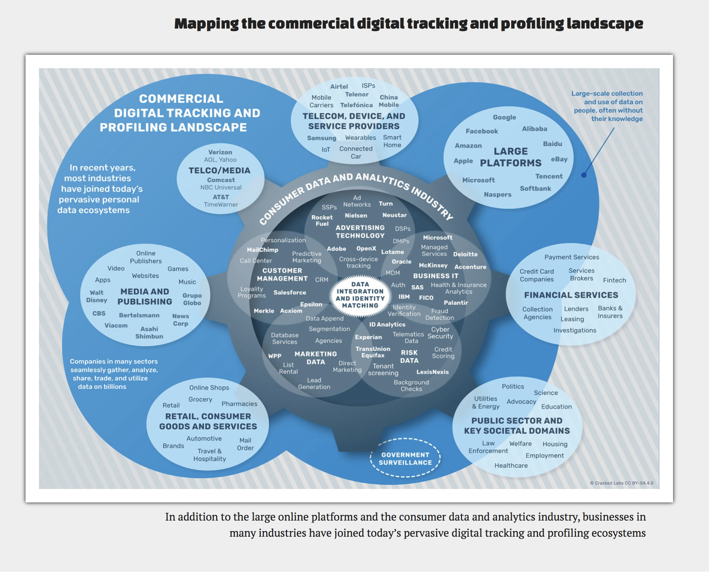
Remember just
how big the
tracking
infrastructure is
Check:
https://crackedlabs.org/en/corporate-surveillance/#6

Slide 44
What does it make us do?
This logic of capital accumulation not just shapes our communication but also shapes our habits, such as the compulsion to constantly check, to broadcast, to lurk and the many activities we identified through our research.
Smart phones have become similar to prosthetics, rarely leaving our hands, converting our time use for the interests of consumption.
Power works through us connecting devices to bodies, people to people and advertisers to us.
This oozing of capital interests for potential future accumulation into our daily life and habits has become normalised – our research participants were “resigned”
This is ideology without ideas, an ideology of expressive action, ideology of form not content, and an ideology of made from connective convenience

Slide 45
The power to extract profit from existence
As we do things we are not just being profiled and targeted, tracked and traded, we are being constantly classified, in more and more extensive and granular detail eg “worth and waste” Cathy O’Neil (2016) WMD shows how these categorisations impact from early education, through to employment, health provision, imprisonment and entrapment in debt for the whole of one’s life.
These are granulated and amalgamated class, race and gender divisions drawn by stealth, without us even knowing that they are happening and certainly not understanding the consequences.
It has also led to a specific relationship between state and capital, whereby the state becomes a service for capital.
For some time Facebook has “just” been operating in the interests of potential accumulation, with no straightforward ideological position and little responsibility. Their editorial position is to follow the money, the source from which they can most potentially profit.
No regulation enables others to manipulate its data for their interests eg reshaping a nation (Brexit)
Facebook only have values when it will increase their value.
This is not about the power to produce a subject but the power to extract profit from existence/ and the performance of subjectivity.
Power works by stealth as the nation, ourselves, our bodies and our means of communication are all shaped by the drive to accumulate?
Power works not through content but through logic and infrastructure.

Slide 46
Conclusion: the grand challenge

Slide 47
What to do in our lives? (for the individual)
We need to be able to rethink what do we want technology to do, not do to us: turn technology to uses fit for us not monopolies.
At a time when stealth is spreading into different spaces and becoming ever more stealthy as the internet of things intrudes into our homes eg Alexa and Echo, for instance, are listening out for us at all times, in our own homes, for “pre-emptive capture”
Avoid anything “smart” – it means capture of your data
Don’t let them in. Don’t give them house room. Don’t accommodate those which make monetising your every minute possible.

Slide 48
2016 advice
Minimize information given
obfuscate
Take back time, break habits, tear off the prosthetic
Avoid all online shopping, ATMs, use public computers. Use cash!
Learn to hack/code
(then change the device identifier on your phone)
Go dumb
Turn them off
Interestingly many of these activities are recommended by the people who designed them…but…

Slide 49
Read privacy policies!
Lorrie Faith Cramer and Aleecia McDonald at Carnegie Mellon decided to calculate how much time it would take to read a privacy policy:
If you were to read every privacy policy on every website you visit would spend 25 days out of the year just reading privacy policies!
If it was your job to read privacy policies for 8 hours per day, it would take you 76 work days to complete the task. Nationalized, that's 53.8 BILLION HOURS of time required to read privacy policies.
The median length of a privacy policy from the top 75 websites turned out to be 2,514 words. The median length of a privacy policy from the top 75 websites turned out to be 2,514 words.
This research was in 2012 – they have become more complex

Slide 50
What to do? Many proposals to regulate and nationalise
New general European data Protection Regulation EU regulation (GDPR) from May 2018 may temporarily deter data blockers because the regulation insists that companies have the consent of those they are using. Trackers should be made visible to users.
Facebook, Google, Amazon and Apple unlikely to be effected by the GDPR as they have “consent” when you sign up and agree terms.
Nationalisation may be a good idea but by what sort of government ? – certainly not the UK one that passed into law in the UK in 2016 the Investigatory Powers Act? An act that gave the police the most sweeping surveillance powers in the Western world? (unmatched even by the US) that legalises state hacking of all mobile and internet communications, one “more suited to a dictatorship than a democracy” (Open Rights Group, 2016)
in 2013 the UK government introduced a patent box subsidy that provides foreign companies investing in the country generous tax breaks worth over £1 billion annually on all profits derived from patented intellectual property.

Slide 51
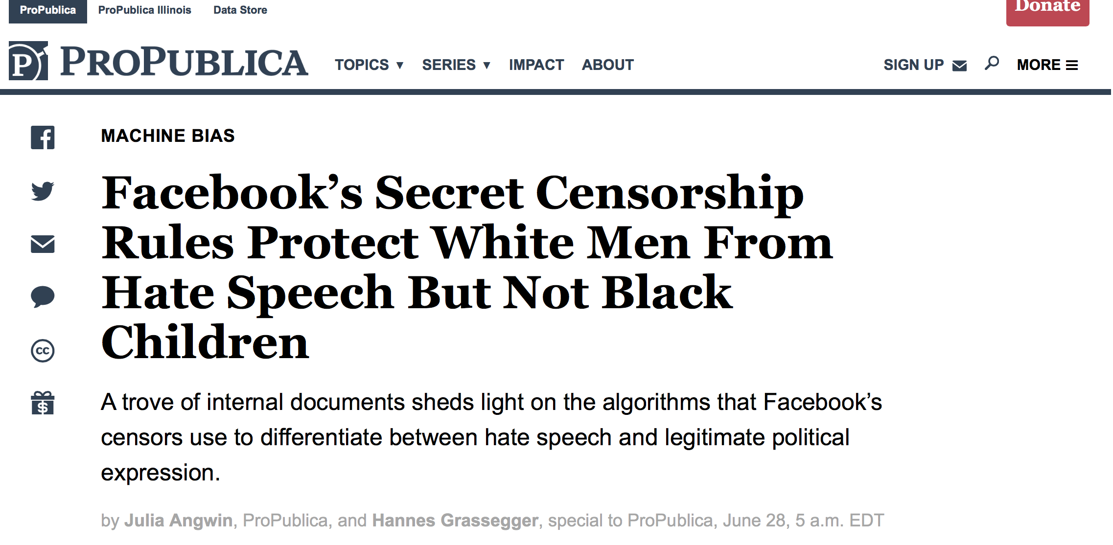
Machine learning and algorithms are not innocent:
In “Algorithms of Oppression” Safiya
Umoja Noble tells of how she
searched for “black girls’ to find her
Search results were directed to
Pornography
As public information resources continue to be defunded, Noble asks us to think about the implications of our ever greater reliance on advertising companies “for information about people, cultures, ideas, and individuals”

Slide 52
States rely on surveillance and trading your data too
How to control state trading of data? (how to even know? Eg Indian AADHAAR system see “Real Media” reports)
How to control state tracking of other nation states eg US of Germany?
The UK government that already uses the services of private companies for its own surveillance of citizens (as revealed by Snowdon and Wikileaks), but also to protect the systems such as the NHS which have been privatised.
Morozov – using the same companies to protect that monetise makes no sense. The state needs internal regulation of its disparate digital services.
The links between states and private companies so entwined eg Palantir/CIA (only revealed when an issue becomes apparent eg Cambridge Analytica and brilliant investigative journalists eg Carole Cadwalladr
Do we know what/why states are collecting data? Think through the implications –data creep
This is beyond individual control, even national control

Slide 53
Blockers; confusers
Via private companies and ad blockers eg Abine DNT+ (http://www.businessinsider.com/this-is-how-facebook-is-tracking-your-internet-activity-2012-9?IR=T)
Free; Track me not (Computer Science, NYU https://cs.nyu.edu/trackmenot/. Works by creating confusion.

Slide 54
Eubanks (2017) “A digital poorhouse”
Most people are targeted for digital security as members of social groups
A feedback loop of injustice – especially as systems integrate and AI/ML – learn from each other’s data.
Automated eligibility systems discourage use
Tested in low-rights environments
Reproduce digital division of deserving/undeserving

Slide 55
AADHAAR: The Indian Identity Card System (or the Silicon Valley biometric gold rush)
The largest biometric database in the world (but also in Kenya, Bangladesh…)
“sold” to population as a means to provide access to welfare, public services, subsidies and rehabilitation provision; “empowerment” of the poor.
But linked to cash machines (Aadhaar Pay), 2016 bill allowed private companies to access all data (but not individuals)
Basic issues – labourers without fingerprints! (36% failure)
Enabled the withdrawal of welfare provision
In 2016 130m users hacked, scores of incorrect data recorded
Wikileaks (26 August 2017) revealed that CIA (plus French and English defence companies) have access to the whole system via the private biometric data company Crossmatch that helped devise AADHAAR (disputed!): see “Realmedia” report for full debate (Indian court rules on data privacy, appealed by Government, ongoing)

Slide 56
Inequality?
By stealth
Classifications unknown
No accountability
Debt silo/sub prime market creation not known until legal challenge reveals it (eg Trump university)
We do not know how our data traces are being traded and valued
We are the fodder, the resource from which value is extracted in order to sell us stuff: a constant circle of expropriation.
Little protection
Litigious companies

Slide 57
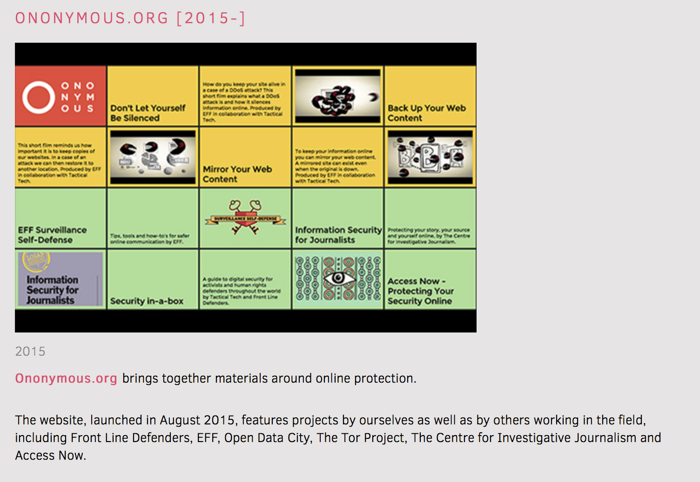
TTC workshops and tools:

Slide 58
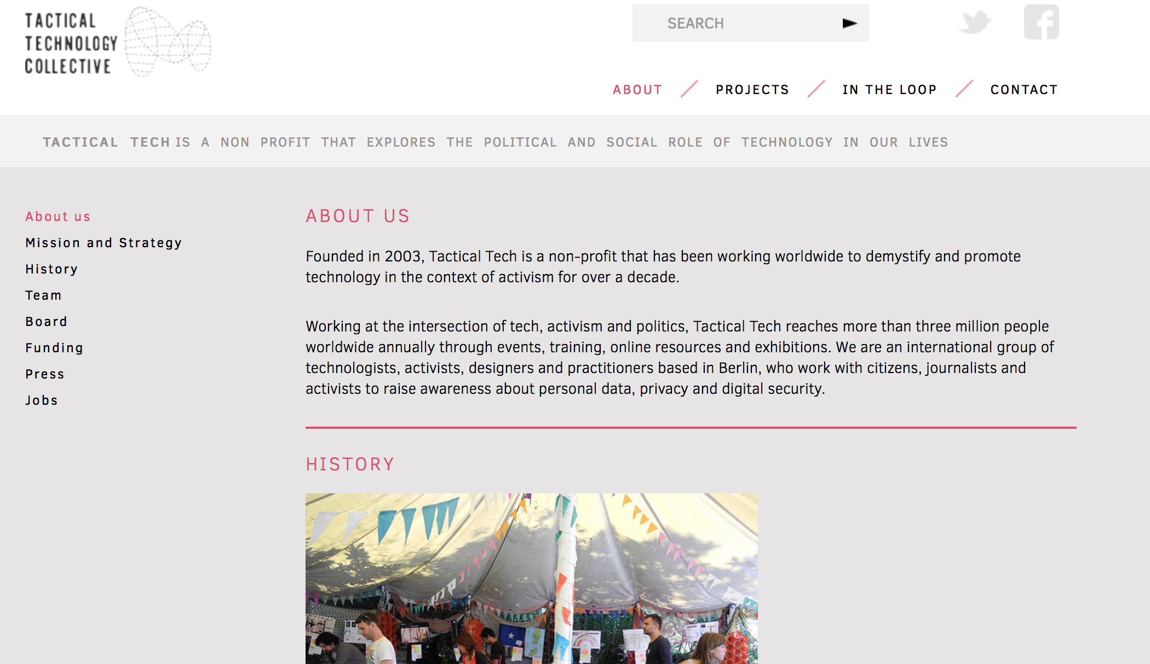
Tactical Technology Collective
https://tacticaltech.org/projects/glass-room-london#

Slide 59
Finally: educate, activate, organise
Find out what is happening to your data
Support research in this area (it’s hard)
Lobby government for regulation (UK has the least) – CA could happen again
Lobby government to prosecute those who use social media for political purposes (eg Brexit)
Organise against monopolies. They need breaking up not given tax subsidies
Organise for children to be protected (this is lifelong data collection that will shape a child’s chances – sub-primed early)
Do everything that you possible can because this is the present and the future

Slide 60
Digital crime includes:
“Digital footprint: that is, the trail of data that is left behind by users of digital services. In an investigative context, this typically relates to mobile and online communications, travel and financial transactions by offenders and victims.
“Internet-facilitated crime: where the internet and smartphones are used in planning or committing traditional criminal or terrorist activity. This ranges from online abuse as part of a neighborhood dispute to communications between terrorists planning attacks.
“Cyber-enabled crimes: such as fraud, the purchasing of illegal drugs or firearms and child sexual exploitation which can be conducted on or offline, but online may take place at unprecedented scale and speed. This might include terrorism, for example, where cyber-enabled fraud is used to fund terrorist activities.
“Cyber-dependent crimes: which can only be committed using computers, computer networks or other forms of information communication technology. They include the creation and spread of malware for financial gain, hacking to steal important personal or industry data and denial of service attacks to cause reputational damage for criminal purposes or terrorism.” (Report on operationalising the Digital Intelligence and Investigation Capabilities Framework – Improving the intelligence and investigative response to an evolving digital environment, College of Policing, July 2014, page 6.)
Source: https://www.justiceinspectorates.gov.uk/hmic/our-work/digital-crime-and-policing/real-lives-real-crimes-a-study-of-digital-crime-and-policing/chapter-1-introduction-background-and-digital-crime/

Slide 61
Most ransomware attacks share a common trait — they begin with one seemingly benign email attachment opened by an
employee. This action introduces malicious code into the network that encrypts or locks critical data (e.g., patient records,
financial information or business documents). One in ten organizations in education has been impacted by Nymaim,
while 34 different government groups have been hit with Locky — which was discovered less than eight months ago —
and has already become the second-most common type of ransomware found across the six industries examined.
Nymaim, although typically associated with ransomware, is actually a Trojan that can be used to install a variety of malware.
Similarly, Matsnu is another type of Trojan malware that can remotely download and execute files.
One unique capability of Matsnu is its ability to lock or unlock computers for ransom.
Education Has Highest Rate of Ransomware
Education has the highest rate of ransomware of all industries examined. In fact, these institutions have over three times the rate of ransomware found in health care and more than 10 times the rate found in finance. With access to social security numbers, medical records, intellectual property, research, and financial data of faculty, staff and students, these institutions are a prime target for cyber attacks.
The rate of ransomware has significantly increased for every industry examined over the last 12 months. Cyber criminals are making a lucrative business through ransomware attacks. Hospitals, in particular, may pay a ransom because their patient data is critical in life-or-death situations. This was the case with Hollywood Presbyterian Medical Center earlier this year, which chose to pay a $17,000 ransom to hackers who had locked some of the hospital's critical data. MedStar Health, another medical center, reported earlier this year that malware had caused a shutdown of some systems at its hospitals in Baltimore. Methodist Hospital in Henderson, Kentucky even declared an internal state of emergency after its systems were attacked by a strain of ransomware known as Locky.
Ransomware: The Rising Face of Cybercrime
ITBusiness Edge Report 2016

Slide 62
Intellectual Property (legitimate?)
IP theft straightforward eg copyright violations, software copy
in 2013 the UK government introduced a patent box subsidy that provides foreign companies investing in the country generous tax breaks worth over £1 billion annually on all profits derived from patented intellectual property.
But what about legitimate IP controls??
Protecting property with patents eg Facebook owns everything about you, that you put on the Facebook site
Do you understand the contract you sign when you download software?
What Facebook has a huge amount of your personal information that can be sold on to advertisers. They have more financial information about a person than banks.
Bruce Schneier” the primary business model of the internet is built on mass surveillance, hence why Zuboff (2015) refers to ‘surveillance capitalism’
The majority of tracking and trading occurs via stealth. We do not know how it is happening.
Making algorithms invisible – Cathy O’Neill (check BBC prog)
Beyond regulation.
We do not know our value eg how much we have been traded for.
We do know the implications of the trade in our own data?

Slide 63
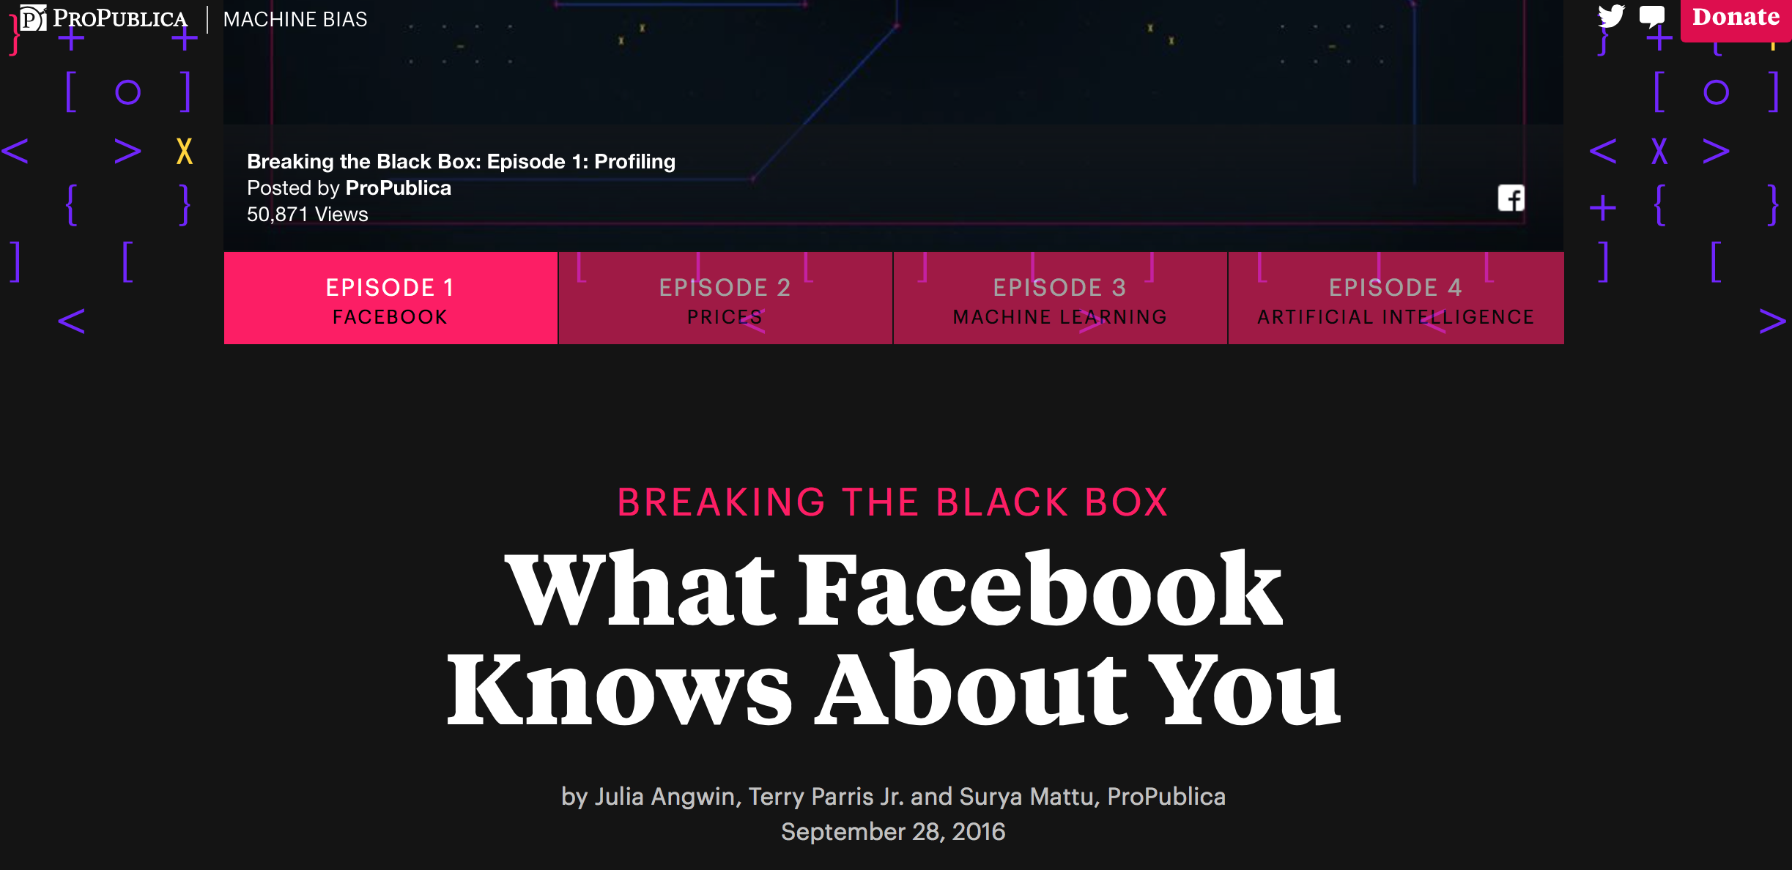

Slide 64
Alternatives to Facebook
https://crabgrass.riseup.net/
https://www.minds.com/ (launched in June 2015)
https://diasporafoundation.org/
https://ello.co/manifesto (launched 2014)
https://www.facebook.com/OffiziellAnonymousPage
Involved in establishing WorldSocial which hosts ZSocial, UTNESocial, DollarsandSenseSocial, SyrizaSocial, GreenSocial (the U.S. Green Party).”There will be no advertising or sale of user information. If a government gets any WorldSocial information, it will be because they stole it”.

Slide 65
https://www.eff.org/deeplinks/2013/02/howto-opt-out-databrokers-showing-your-targeted-advertisements-facebook
https://lifehacker.com/5994380/how-facebook-uses-your-data-to-target-ads-even-offline
https://lifehacker.com/5843969/facebook-is-tracking-your-every-move-on-the-web-heres-how-to-stop-it
https://www.wired.com/story/to-fix-its-toxic-ad-problem-facebook-must-break-itself?mbid=nl_091817_daily&CNDID=%%CUST_ID%%

Slide 66
2019
Zuckerberg explains his good intentions, one more timehttps://www.cnet.com/news/mark-zuckerberg-defends-facebook-advertising-model-we-dont-sell-peoples-data/
Life without the tech giants, including youtube videos
https://gizmodo.com/life-without-the-tech-giants-1830258056
https://www.youtube.com/watch?v=zNSp-kzVVhU&index=1&list=PLx1XbvvfIlc4zQgE5ohJA9EJ2NCcGc2QQ
https://www.youtube.com/watch?v=FGyEirsta_0&index=2&list=PLx1XbvvfIlc4zQgE5ohJA9EJ2NCcGc2QQ
The fall of Facebook has only begun
https://medium.com/@13DResearch/the-fall-of-facebook-has-only-begun-9d73a45adc8
(it was reported that 640.000 users in NL left Facebook in 2018)
Analysis of the German court decision against Facebook (in German)
https://netzpolitik.org/2019/kartellamtsentscheidung-zu-facebook-richtige-analyse-schwaches-schwert/
Facebook and Drug Abuse Link Suggests "Social Media Addiction" Is Real
https://www.inverse.com/article/52358-is-social-media-an-addiction-like-gambling-or-drugs

